Slide 1
Envelope, Template matching and STFT features: recap
October 2024
Andrea Corrado

Slide 2
Outline
Envelope definition and analysis
Envelope features
Template matching definition and analysis
Template matching features
Short time Fourier transformation definition and analysis
Conclusions

Slide 3
Outline
Envelope definition and analysis
Envelope features
Template matching definition and analysis
Template matching features
Short time Fourier transformation definition and analysis
Conclusions

Slide 4
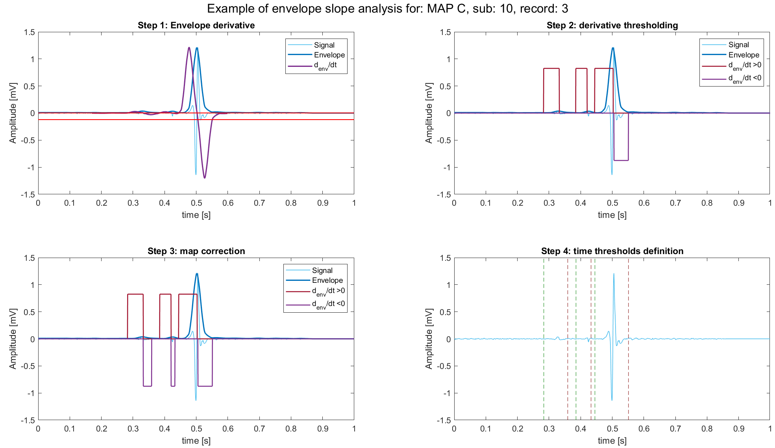
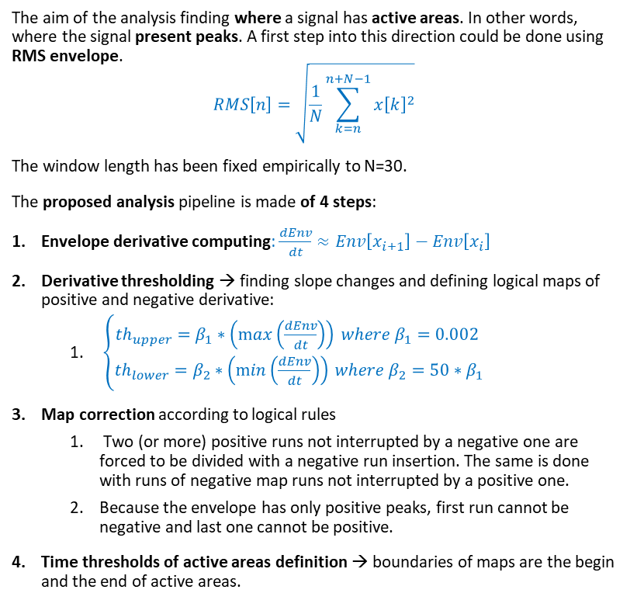
Envelope definition and peak recognition
The aim of the analysis finding where a signal has active areas. In other words, where the signal present peaks. A first step into this direction could be done using RMS envelope.
$$RMS\left[n\right]=\sqrt{\frac{1}{N}\sum_{k=n}^{n+N−1}{x{\left[k\right]}^{2}}}$$
The window length has been fixed empirically to N=30.
The proposed analysis pipeline is made of 4 steps:
Envelope derivative computing: $\frac{dEnv}{dt}≈Env\left[x_{i+1}\right]−Env\left[x_{i}\right]$
Derivative thresholding → finding slope changes and defining logical maps of positive and negative derivative:
$\left\{\begin{aligned}th_{upper}=β_{1}∗\left(\max\left(\frac{dEnv}{dt}\right)\right) where β_{1}=0.002 \\ th_{lower}=β_{2}∗\left(\min\left(\frac{dEnv}{dt}\right)\right) where β_{2}=50∗β_{1}\end{aligned}\right.$
Map correction according to logical rules
Two (or more) positive runs not interrupted by a negative one are forced to be divided with a negative run insertion. The same is done with runs of negative map runs not interrupted by a positive one.
Because the envelope has only positive peaks, first run cannot be negative and last one cannot be positive.
Time thresholds of active areas definition → boundaries of maps are the begin and the end of active areas.
NB: signal has been windowed between 0.17 and 0.6 seconds.

Slide 5
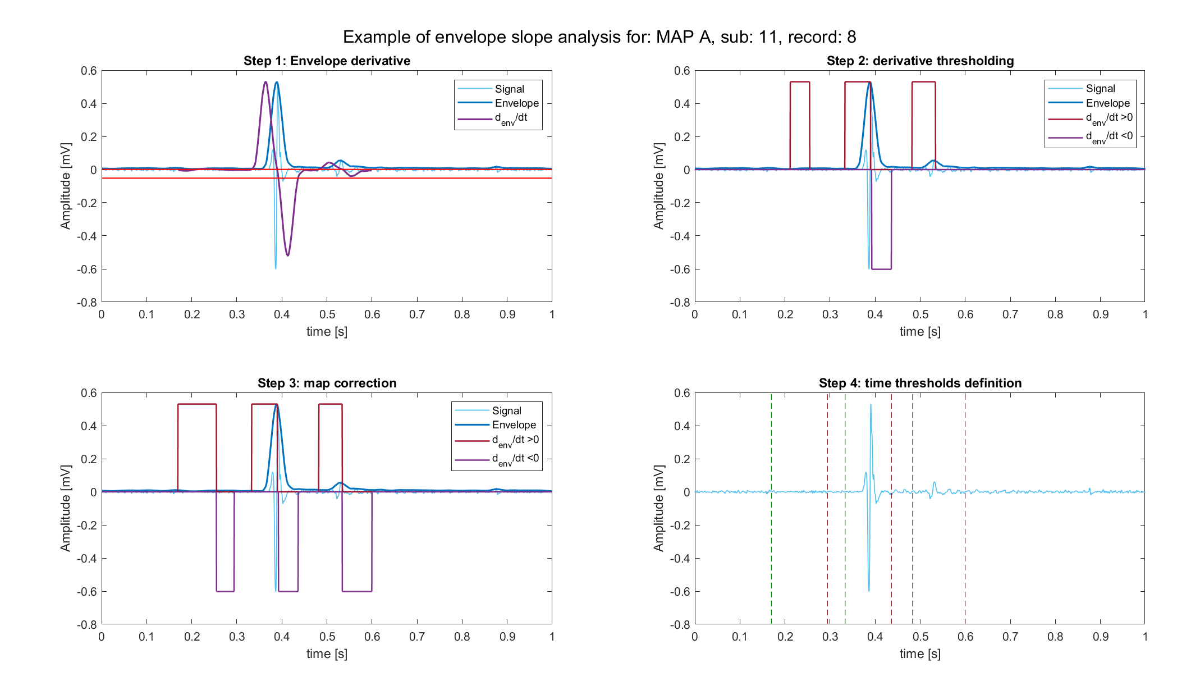
MAP A example

Slide 6
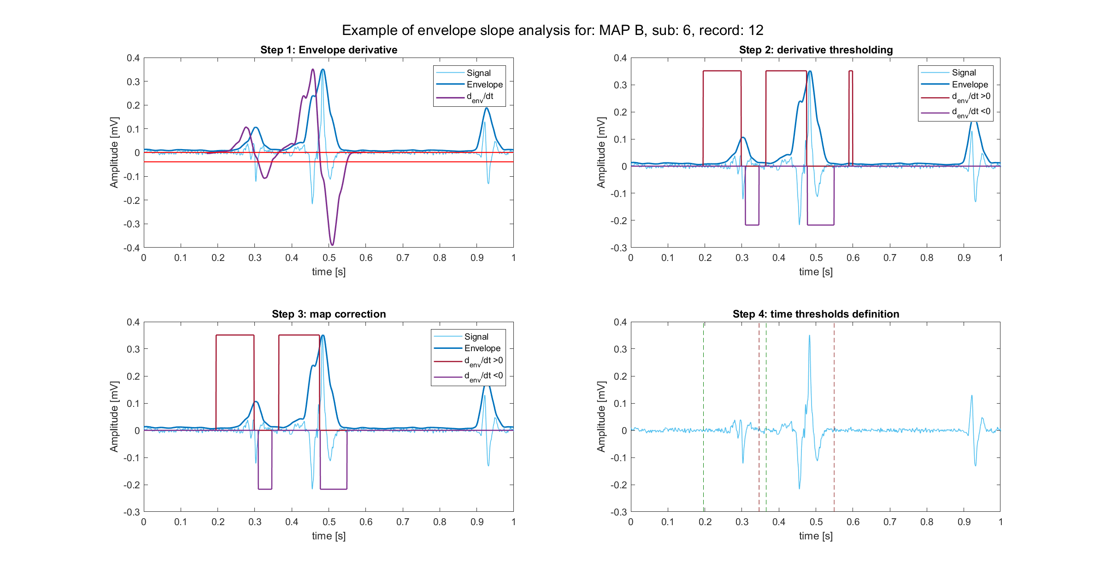
MAP B example

Slide 7
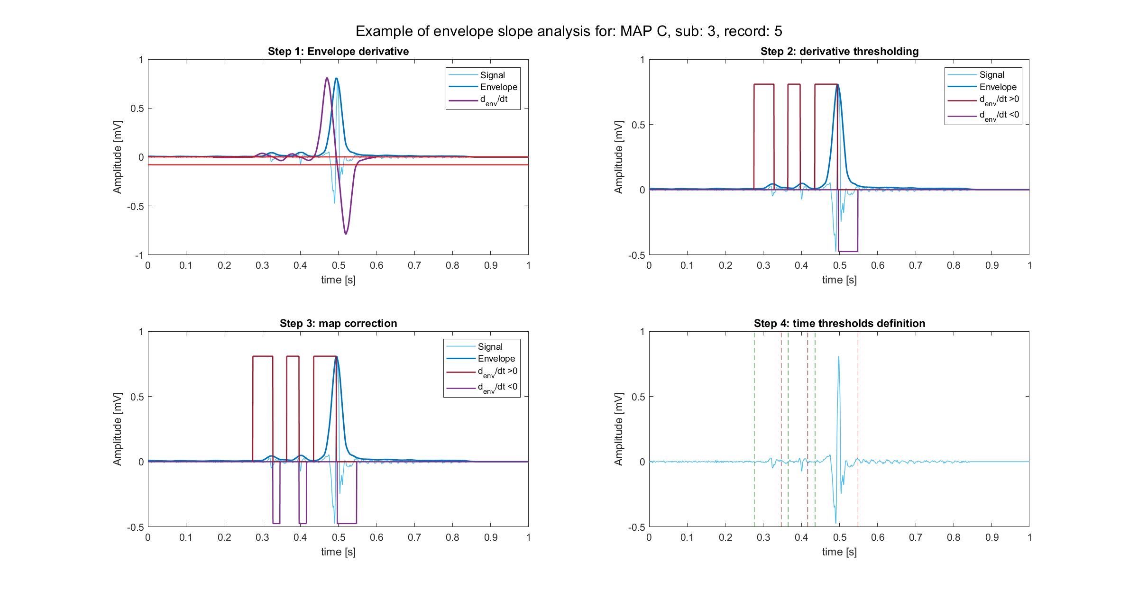
MAP C example

Slide 8
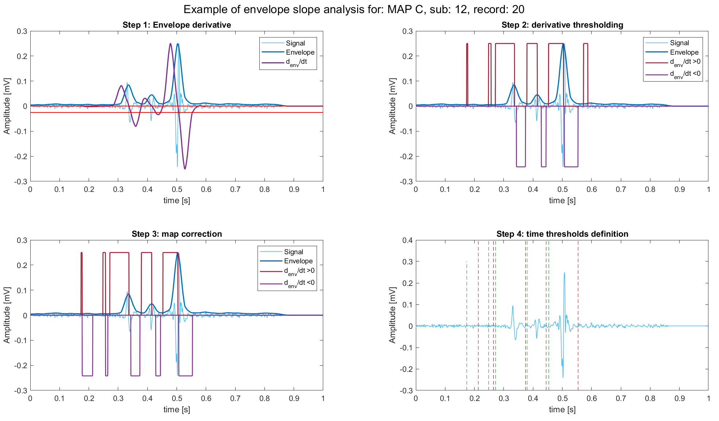
The over-detecting problem
This pipeline has, by building, a peculiarity: peaks are found in superabundance. In fact:
high sensibility of the upper threshold, even noise could be detected as peak.
the logic used into map cleaning favors the detection of new peaks.
In other words, this pipeline works with the logic “the higher, the better”.
This problem could be solved into peak detection phase, but it has been chosen to “leave to work” to feature extraction phase.
Peaks finally detected are the three main peaks (in descending order) of the signal
With such definition, a noise peak could be easily discharged, at least if the signal is not too noisy (but even a less sensible pipeline would be deceived in this case).

Slide 9
Outline
Envelope definition and analysis
Envelope features
Template matching definition and analysis
Template matching features
Short time Fourier transformation definition and analysis
Conclusions

Slide 10
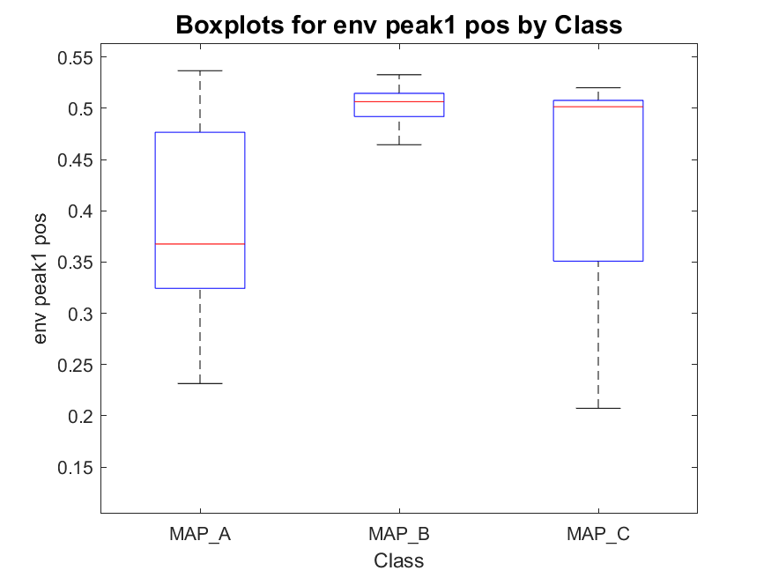
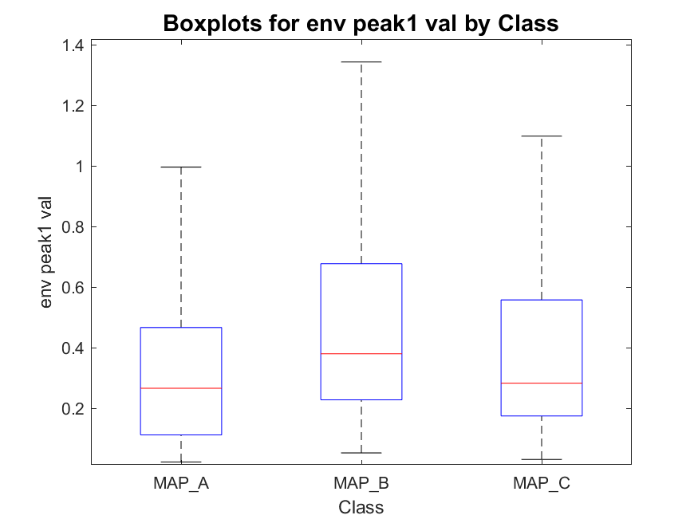
Envelope peak 1 (highest) position and value
MAP_A has:
- 22 signals with one peak
- 254 signals with two peaks
- 387 signals with three peaks
total : 663
MAP_B has:
- 0 signals with one peak
- 41 signals with two peaks
- 53 signals with three peaks
total : 94
MAP_C has:
- 2 signals with one peak
- 12 signals with two peaks
- 76 signals with three peaks
total : 90

Slide 11
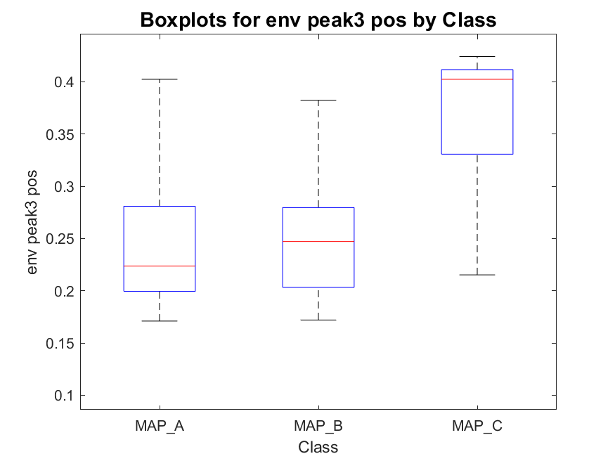
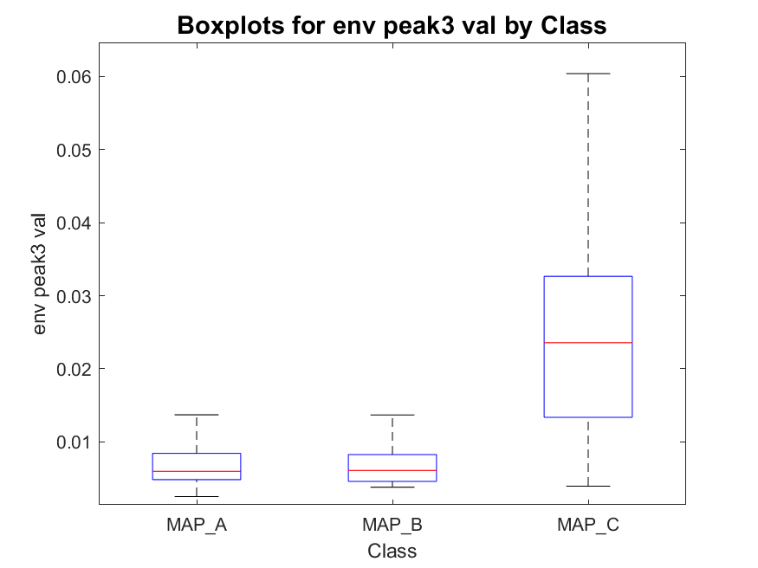
Envelope peak 3 (third highest) position and value
MAP_A has:
- 22 signals with one peak
- 254 signals with two peaks
- 387 signals with three peaks
total : 663
MAP_B has:
- 0 signals with one peak
- 41 signals with two peaks
- 53 signals with three peaks
total : 94
MAP_C has:
- 2 signals with one peak
- 12 signals with two peaks
- 76 signals with three peaks
total : 90

Slide 12
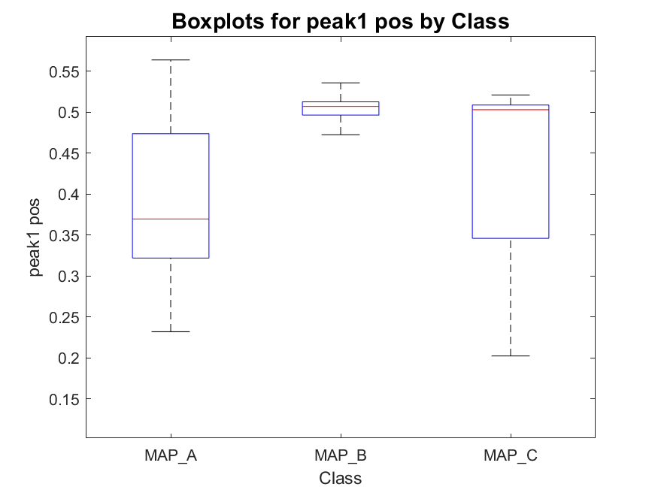
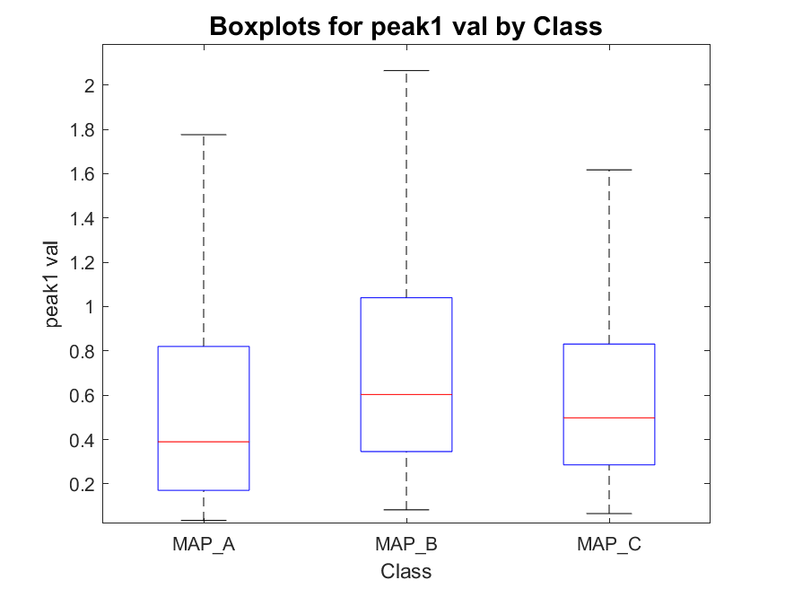
Signals absolute peak 1 (highest) position and value
MAP_A has:
- 22 signals with one peak
- 254 signals with two peaks
- 387 signals with three peaks
total : 663
MAP_B has:
- 0 signals with one peak
- 41 signals with two peaks
- 53 signals with three peaks
total : 94
MAP_C has:
- 2 signals with one peak
- 12 signals with two peaks
- 76 signals with three peaks
total : 90

Slide 13
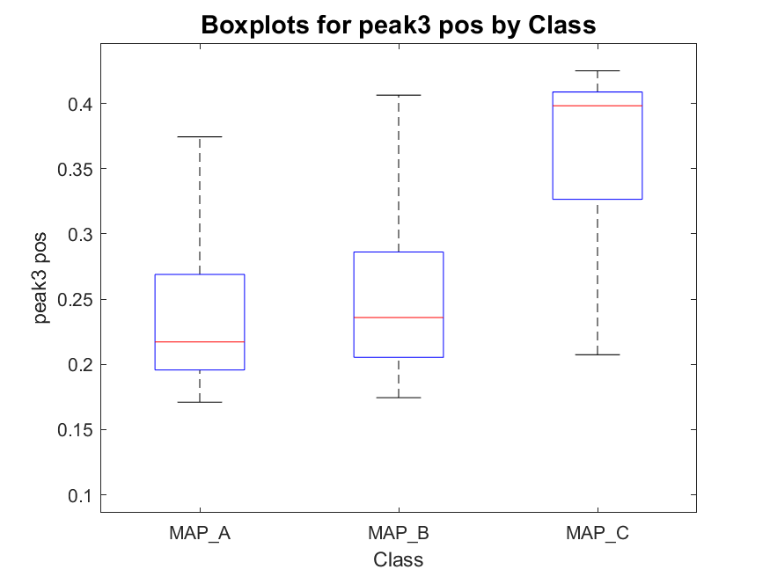
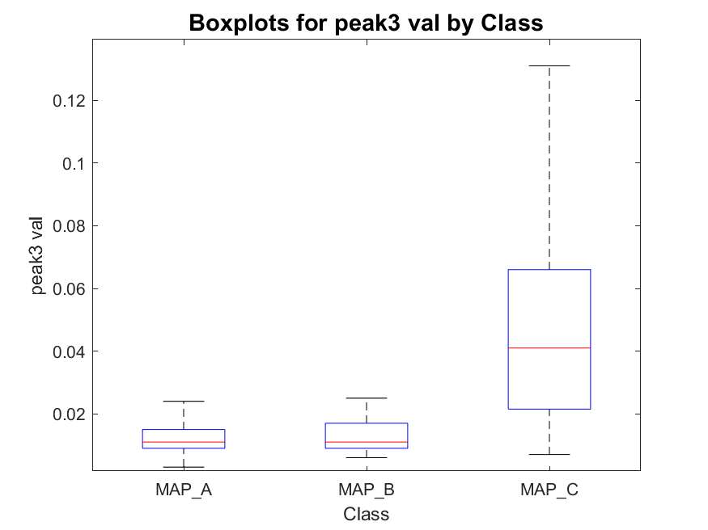
Signal absolute peak 3 (third highest) position and value
MAP_A has:
- 22 signals with one peak
- 254 signals with two peaks
- 387 signals with three peaks
total : 663
MAP_B has:
- 0 signals with one peak
- 41 signals with two peaks
- 53 signals with three peaks
total : 94
MAP_C has:
- 2 signals with one peak
- 12 signals with two peaks
- 76 signals with three peaks
total : 90

Slide 14
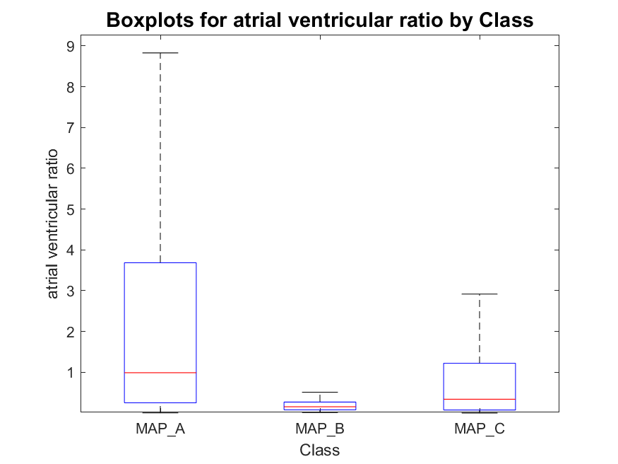
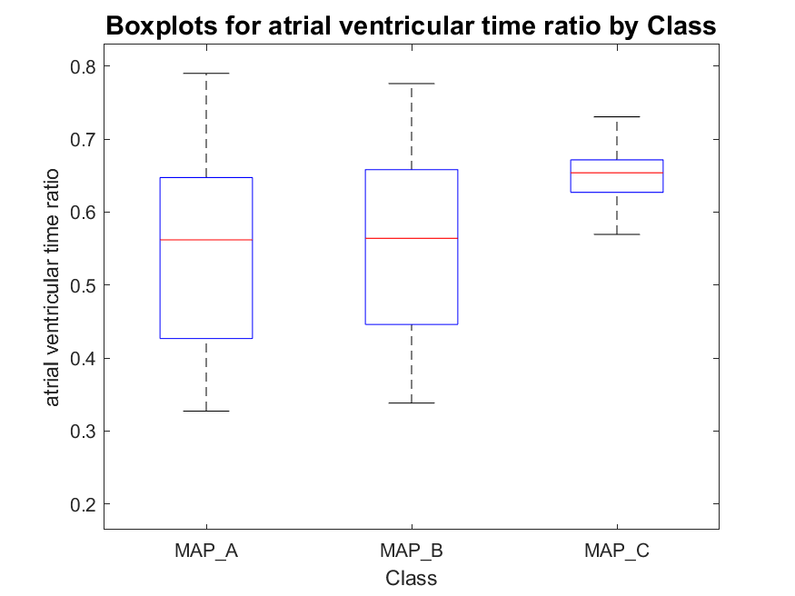
Atrial-to-ventricular envelope peaks ratio
MAP_A has:
- 22 signals with one peak
- 254 signals with two peaks
- 387 signals with three peaks
total : 663
MAP_B has:
- 0 signals with one peak
- 41 signals with two peaks
- 53 signals with three peaks
total : 94
MAP_C has:
- 2 signals with one peak
- 12 signals with two peaks
- 76 signals with three peaks
total : 90
NB: in case of single peak detection, the second one was found before or after the detected one as the maximum of the signal (in modulus) into the segment of signal following or preceding the peak detected.

Slide 15
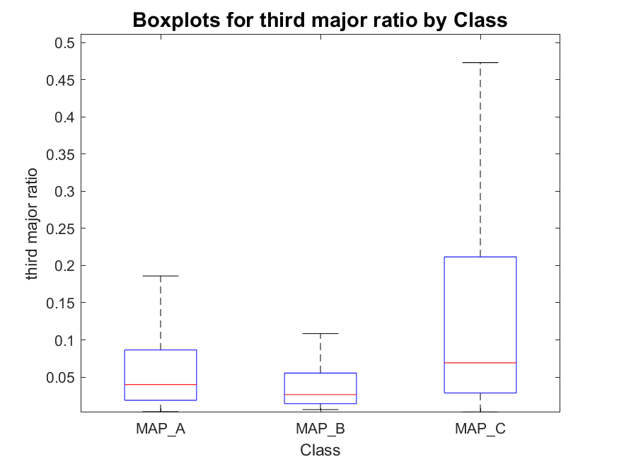
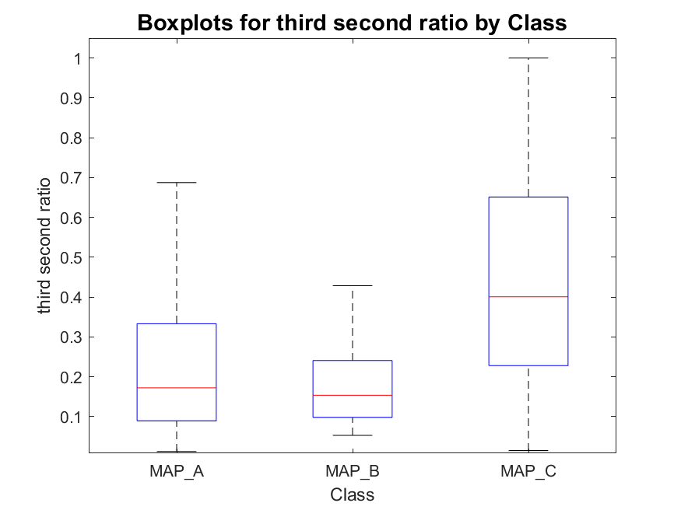
Active phase duration and silent phase duration
MAP_A has:
- 22 signals with one peak
- 254 signals with two peaks
- 387 signals with three peaks
total : 663
MAP_B has:
- 0 signals with one peak
- 41 signals with two peaks
- 53 signals with three peaks
total : 94
MAP_C has:
- 2 signals with one peak
- 12 signals with two peaks
- 76 signals with three peaks
total : 90

Slide 16
Outline
Envelope definition and analysis
Envelope features
Template matching definition and analysis
Template matching features
Short time Fourier transformation definition and analysis
Conclusions

Slide 17
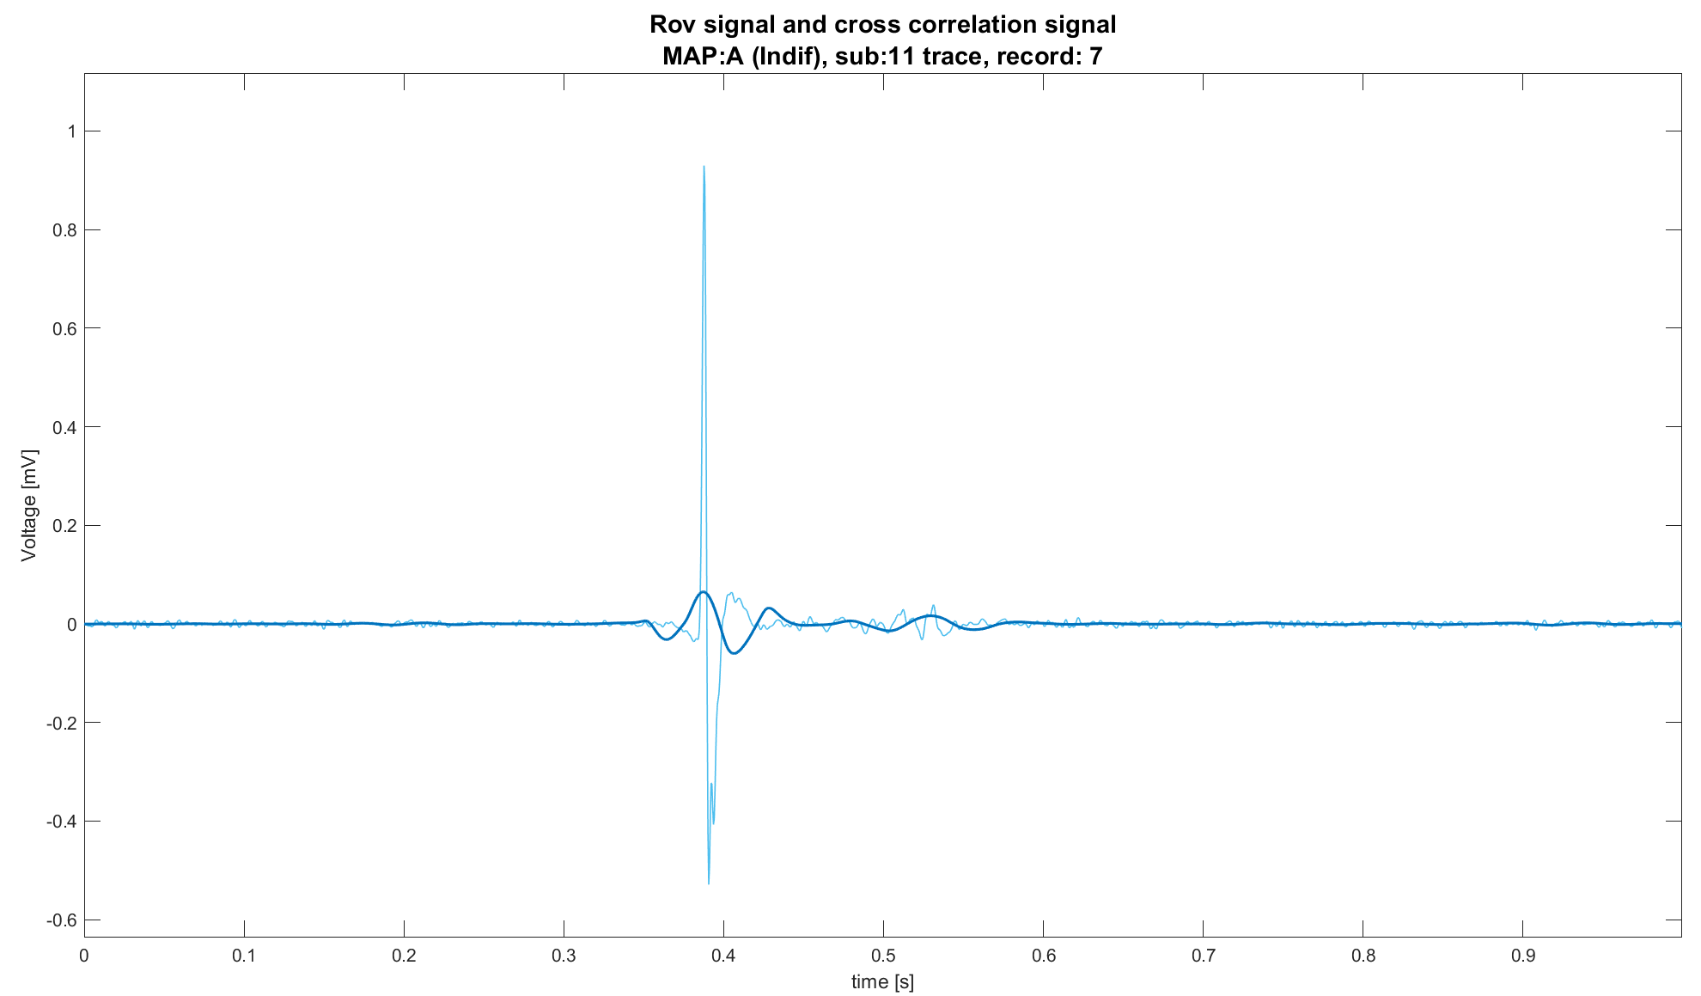
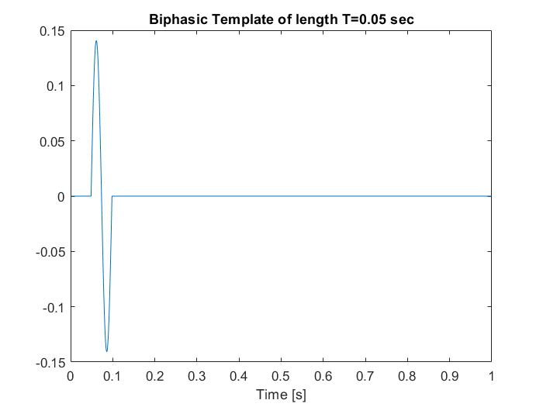
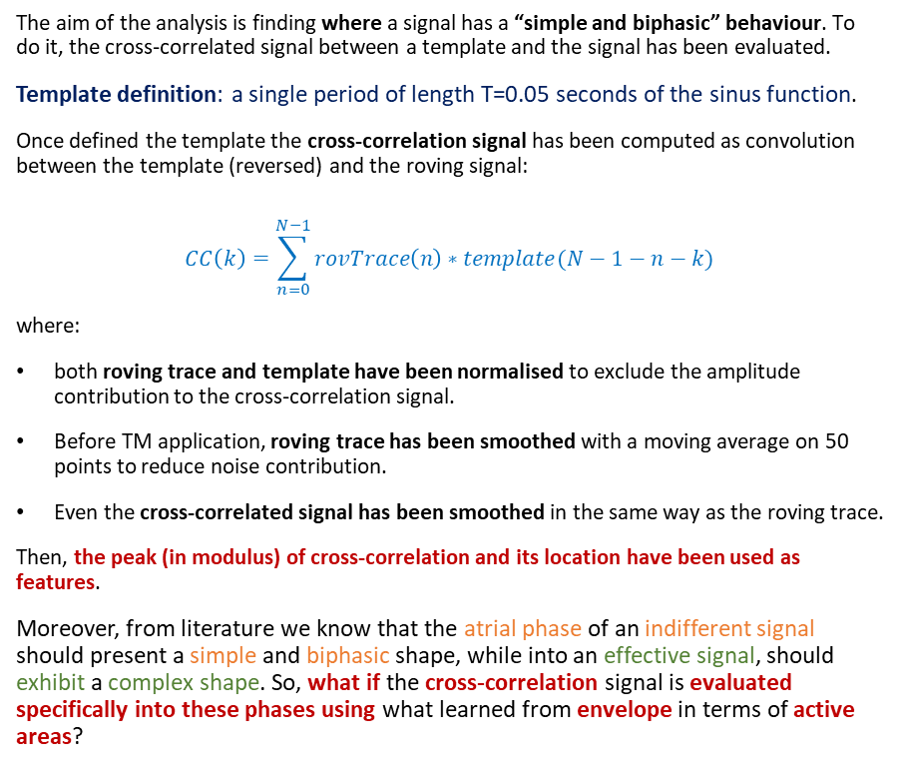

Template matching definition
The aim of the analysis is finding where a signal has a “simple and biphasic” behaviour. To do it, the cross-correlated signal between a template and the signal has been evaluated.
Template definition: a single period of length T=0.05 seconds of the sinus function.
Once defined the template the cross-correlation signal has been computed as convolution between the template (reversed) and the roving signal:
$$CC\left(k\right)=\sum_{n=0}^{N−1}{rovTrace\left(n\right)∗template(N−1−n−k)}$$
where:
both roving trace and template have been normalised to exclude the amplitude contribution to the cross-correlation signal.
Before TM application, roving trace has been smoothed with a moving average on 50 points to reduce noise contribution.
Even the cross-correlated signal has been smoothed in the same way as the roving trace.
Then, the peak (in modulus) of cross-correlation and its location have been used as features.
Moreover, from literature we know that the atrial phase of an indifferent signal should present a simple and biphasic shape, while into an effective signal, should exhibit a complex shape. So, what if the cross-correlation signal is evaluated specifically into these phases using what learned from envelope in terms of active areas?
$$(peak,t_{peak})$$

Slide 18
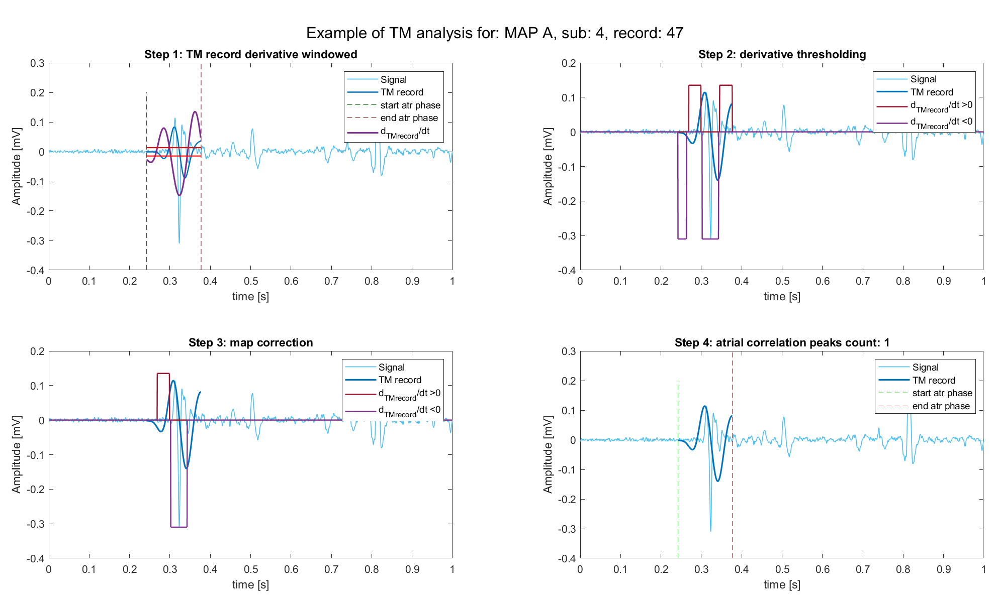
Template matching analysis into active areas
Following what has been done into envelope analysis, TM has been done into the active areas of signal with the following pipeline:
Using envelope, atrial phase has been detected, and TM has been computed into this phase
Cross-correlation signal derivative has been used, together with a threshold, to find areas of positive and negative slopes
Maps have been corrected using logical rules:
A peak begin with a positive slopes and ends with a negative one
Multiple runs of positive slopes (or negative) are false peaks.
The total number of positive peaks into the atrial phase, their values, the energy of the cross-correlation signal into this phase have been computed as features, together with ratios between them.
The same analysis has been done with the ventricular phase.

Slide 19
Outline
Envelope definition and analysis
Envelope features
Template matching definition and analysis
Template matching features
Short time Fourier transformation definition and analysis
Conclusions

Slide 20
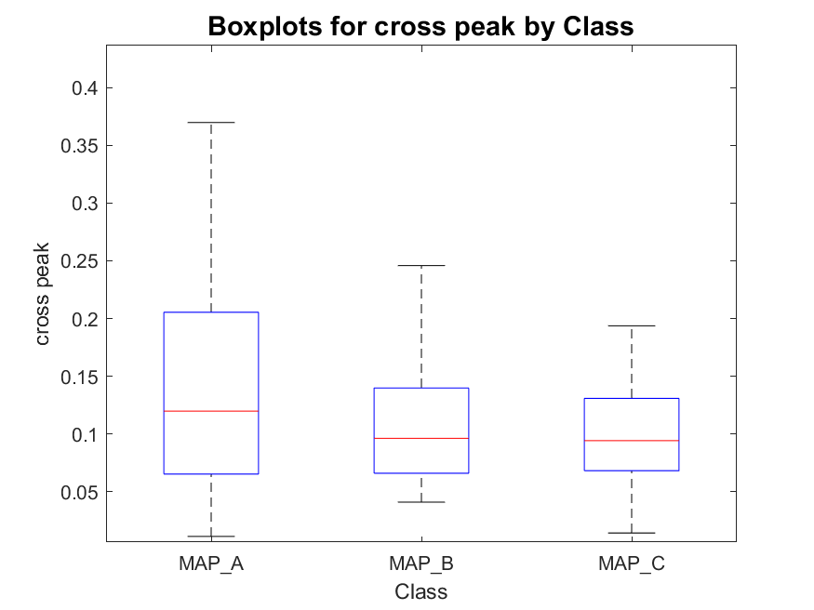
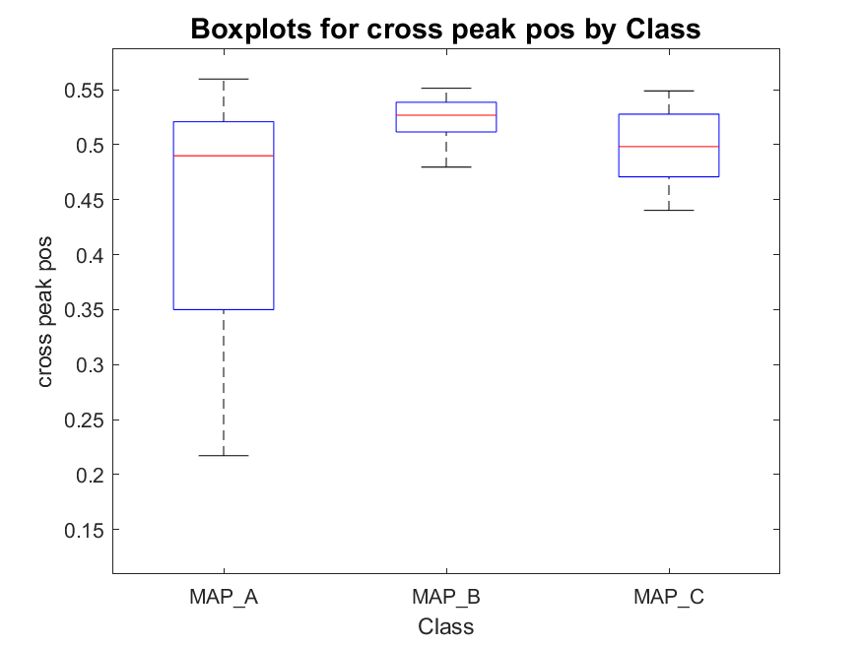
Cross correlation peak position and value
MAP_A has:
- 22 signals with one peak
- 254 signals with two peaks
- 387 signals with three peaks
total : 663
MAP_B has:
- 0 signals with one peak
- 41 signals with two peaks
- 53 signals with three peaks
total : 94
MAP_C has:
- 2 signals with one peak
- 12 signals with two peaks
- 76 signals with three peaks
total : 90

Slide 21
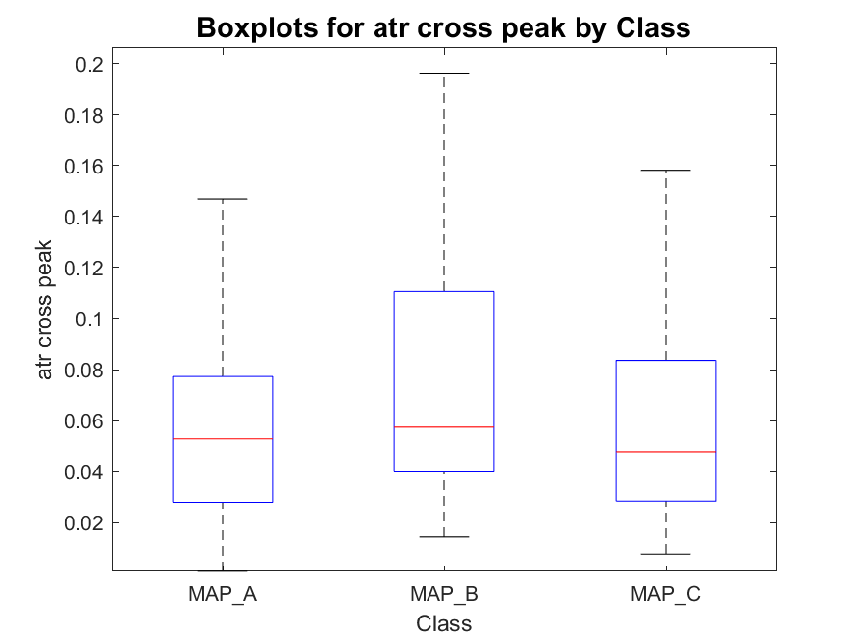
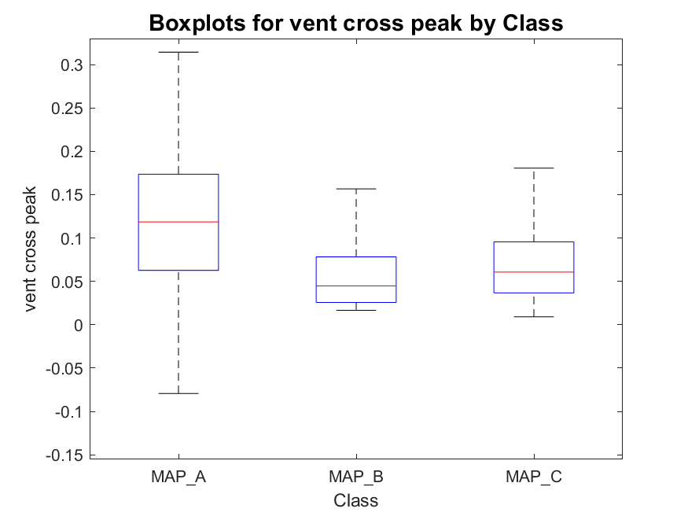
Atrial and ventricular cross peak value
MAP_A has:
- 22 signals with one peak
- 254 signals with two peaks
- 387 signals with three peaks
total : 663
MAP_B has:
- 0 signals with one peak
- 41 signals with two peaks
- 53 signals with three peaks
total : 94
MAP_C has:
- 2 signals with one peak
- 12 signals with two peaks
- 76 signals with three peaks
total : 90

Slide 22
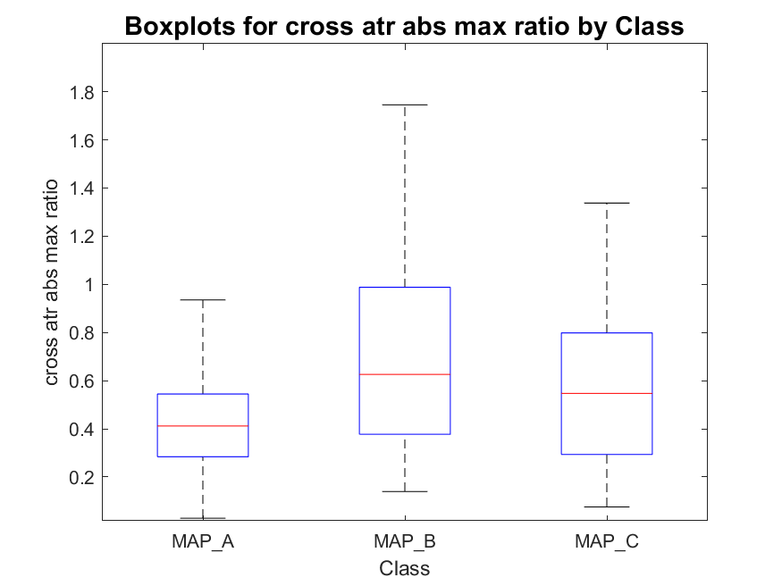
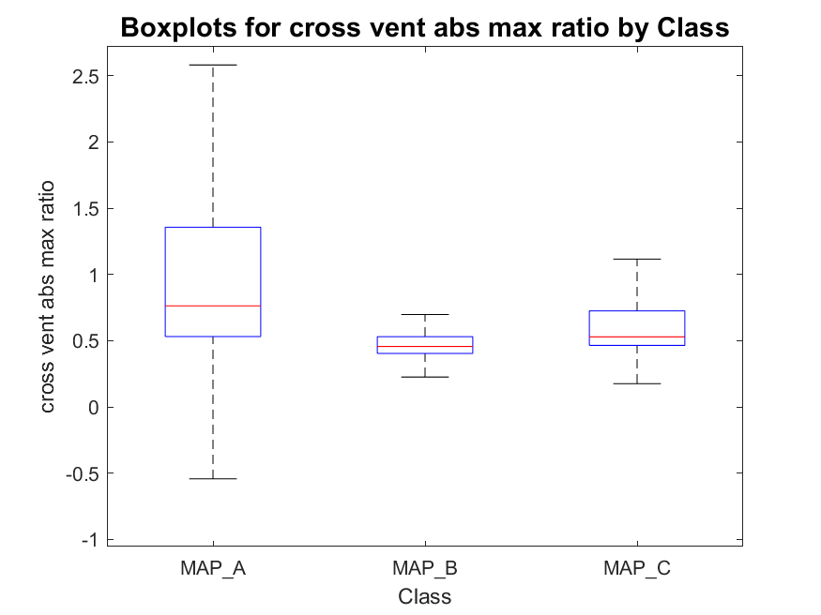
Atrial (and ventricular) cross peak to cross peak ratio
MAP_A has:
- 22 signals with one peak
- 254 signals with two peaks
- 387 signals with three peaks
total : 663
MAP_B has:
- 0 signals with one peak
- 41 signals with two peaks
- 53 signals with three peaks
total : 94
MAP_C has:
- 2 signals with one peak
- 12 signals with two peaks
- 76 signals with three peaks
total : 90

Slide 23
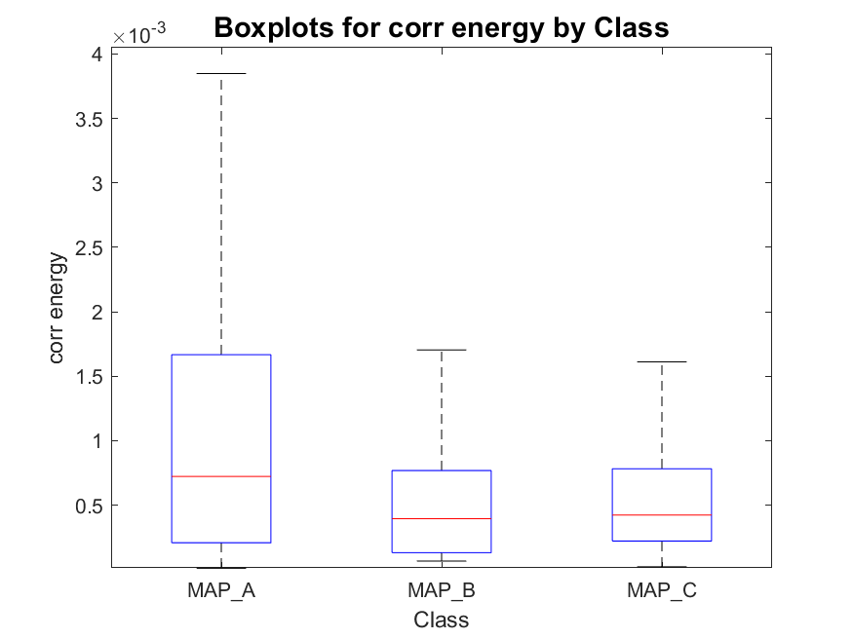
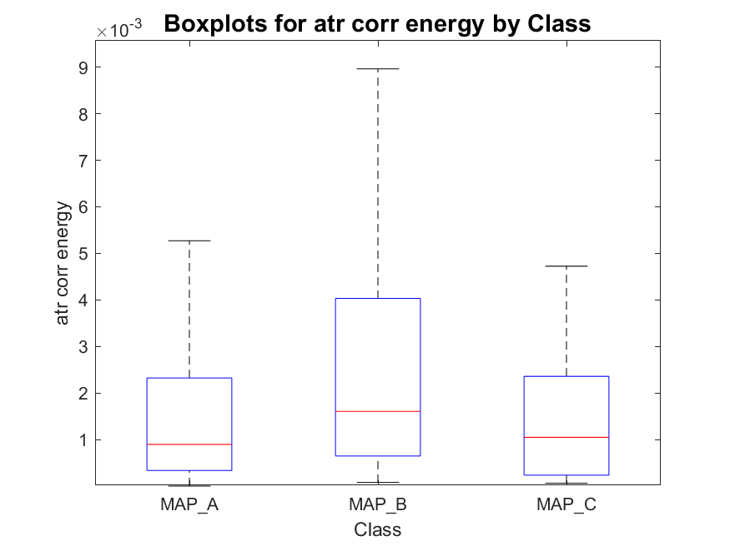
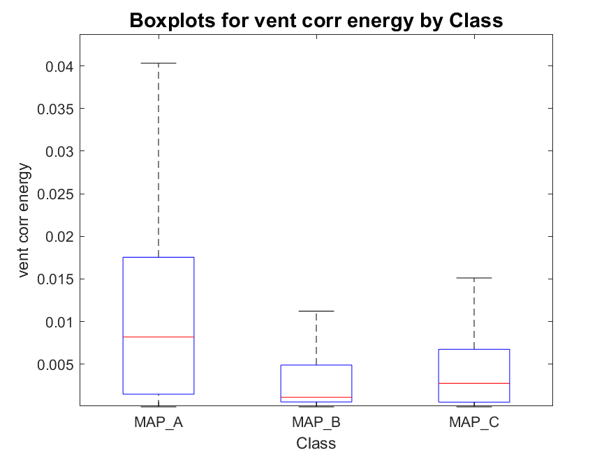
Energy of whole cross signal, atrial and ventricular phases
MAP_A has:
- 22 signals with one peak
- 254 signals with two peaks
- 387 signals with three peaks
total : 663
MAP_B has:
- 0 signals with one peak
- 41 signals with two peaks
- 53 signals with three peaks
total : 94
MAP_C has:
- 2 signals with one peak
- 12 signals with two peaks
- 76 signals with three peaks
total : 90

Slide 24
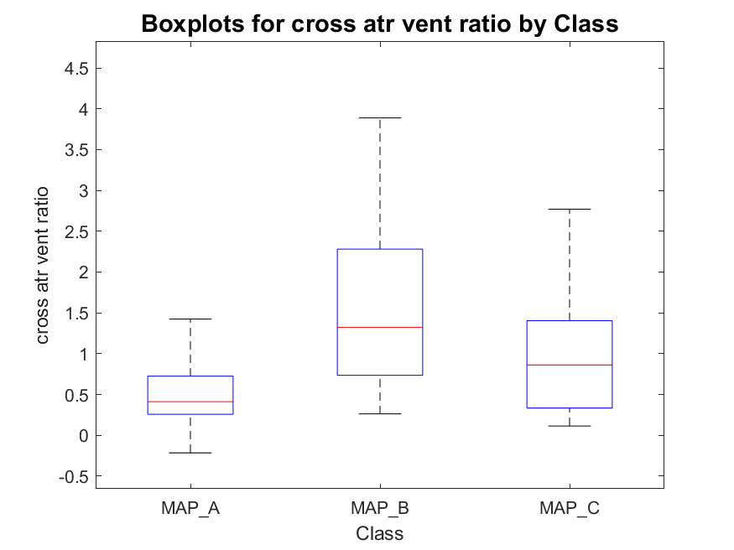
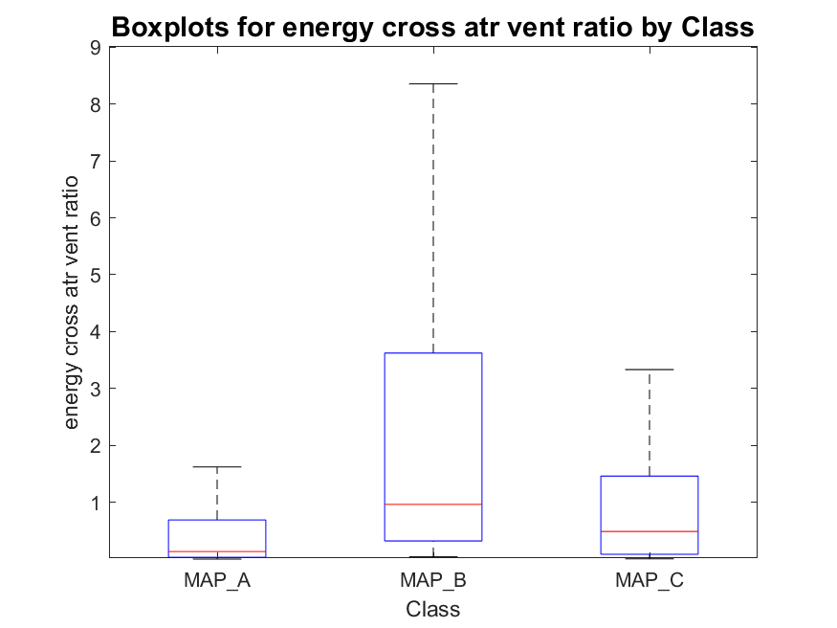
Atrial-to-ventricular cross peaks (and energy) ratio
MAP_A has:
- 22 signals with one peak
- 254 signals with two peaks
- 387 signals with three peaks
total : 663
MAP_B has:
- 0 signals with one peak
- 41 signals with two peaks
- 53 signals with three peaks
total : 94
MAP_C has:
- 2 signals with one peak
- 12 signals with two peaks
- 76 signals with three peaks
total : 90
NB: in case of single peak detection, the second one was found before or after the detected one as the maximum of the signal (in modulus) into the segment of signal following or preceding the peak detected.

Slide 25
Outline
Envelope definition and analysis
Envelope features
Template matching definition and analysis
Template matching features
Short time Fourier transformation definition and analysis
Conclusions

Slide 26
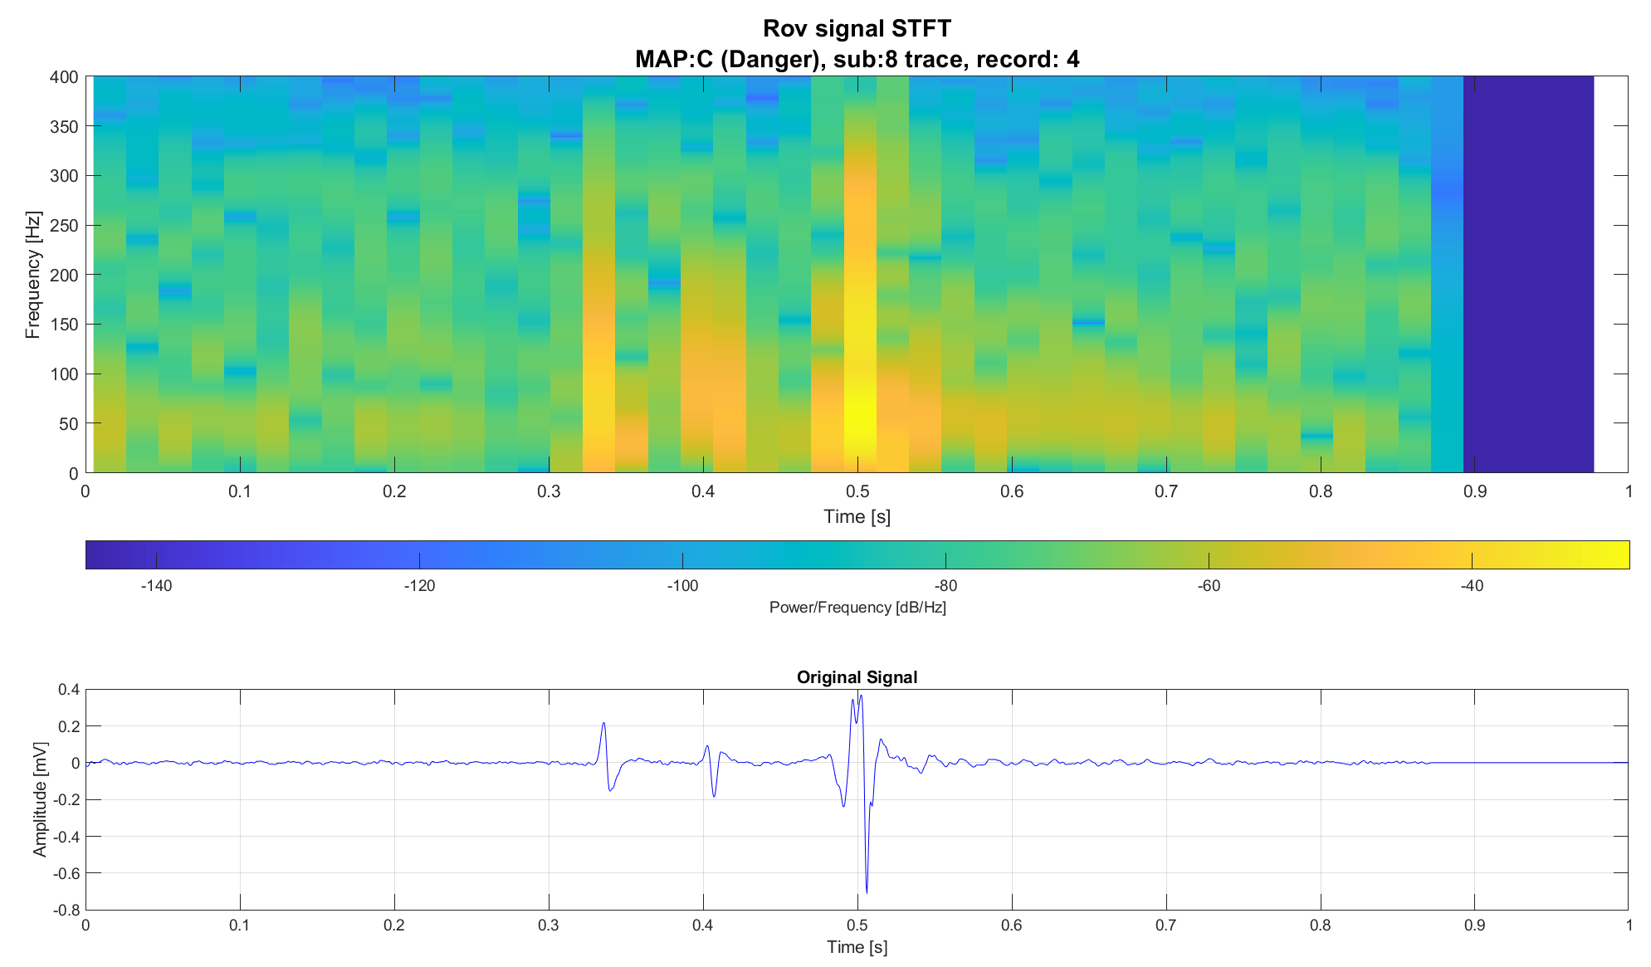
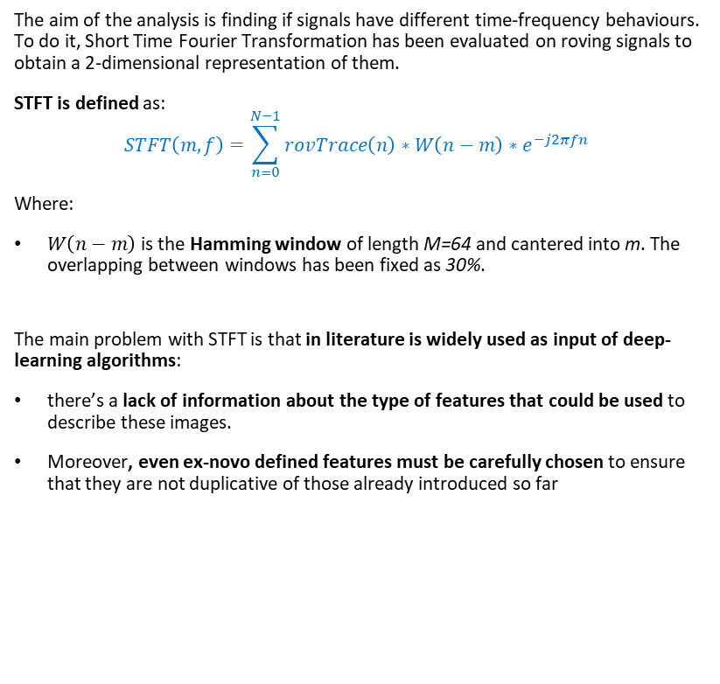
STFT definition
The aim of the analysis is finding if signals have different time-frequency behaviours. To do it, Short Time Fourier Transformation has been evaluated on roving signals to obtain a 2-dimensional representation of them.
STFT is defined as:
$$STFT\left(m,f\right)=\sum_{n=0}^{N−1}{rovTrace\left(n\right)∗W\left(n−m\right)∗e^{−j2πfn} }$$
Where:
$W\left(n−m\right)$ is the Hamming window of length M=64 and cantered into m. The overlapping between windows has been fixed as 30%.
The main problem with STFT is that in literature is widely used as input of deep-learning algorithms:
there’s a lack of information about the type of features that could be used to describe these images.
Moreover, even ex-novo defined features must be carefully chosen to ensure that they are not duplicative of those already introduced so far

Slide 27
Outline
Envelope definition and analysis
Envelope features
Template matching definition and analysis
Template matching features
Short time Fourier transformation definition and analysis
Conclusions

Slide 28
Conclusions
Two feature extraction pipelines based on envelope analysis and template matching have proposed:
Envelope features provides information on peaks positions and active areas of the signal
Template matching features provides information on signal morphology
Moreover, STFT usage has been explored but features have not been evaluated for the time being as they would have to be meticulously defined from scratch. Otherwise, redundant information would be introduced.
In the following will be defined and analyzed 3 models:
An improved Knowledge based model based on envelope features
A decision tree (LOPO cross validation) trained onto the whole feature set
A decision tree (LOPOCV) trained onto a optimized feature set

Slide 29
Knowledge based classifier with new features
For each roving trace:
Improved KB V0: peaks thresholds and position
Improved KB V1: peaks thresholds and atrial/ventricular ratio
Is third peak >0.021?
No
Is peak_1_pos<0.49
No
Is third peak >0.021?
No
Is atrial_ventricular_ratio >0.09?
No
MAP B
MAP B
Yes
Yes
Yes
Yes
MAP C
MAP A
MAP C
MAP A

Slide 30
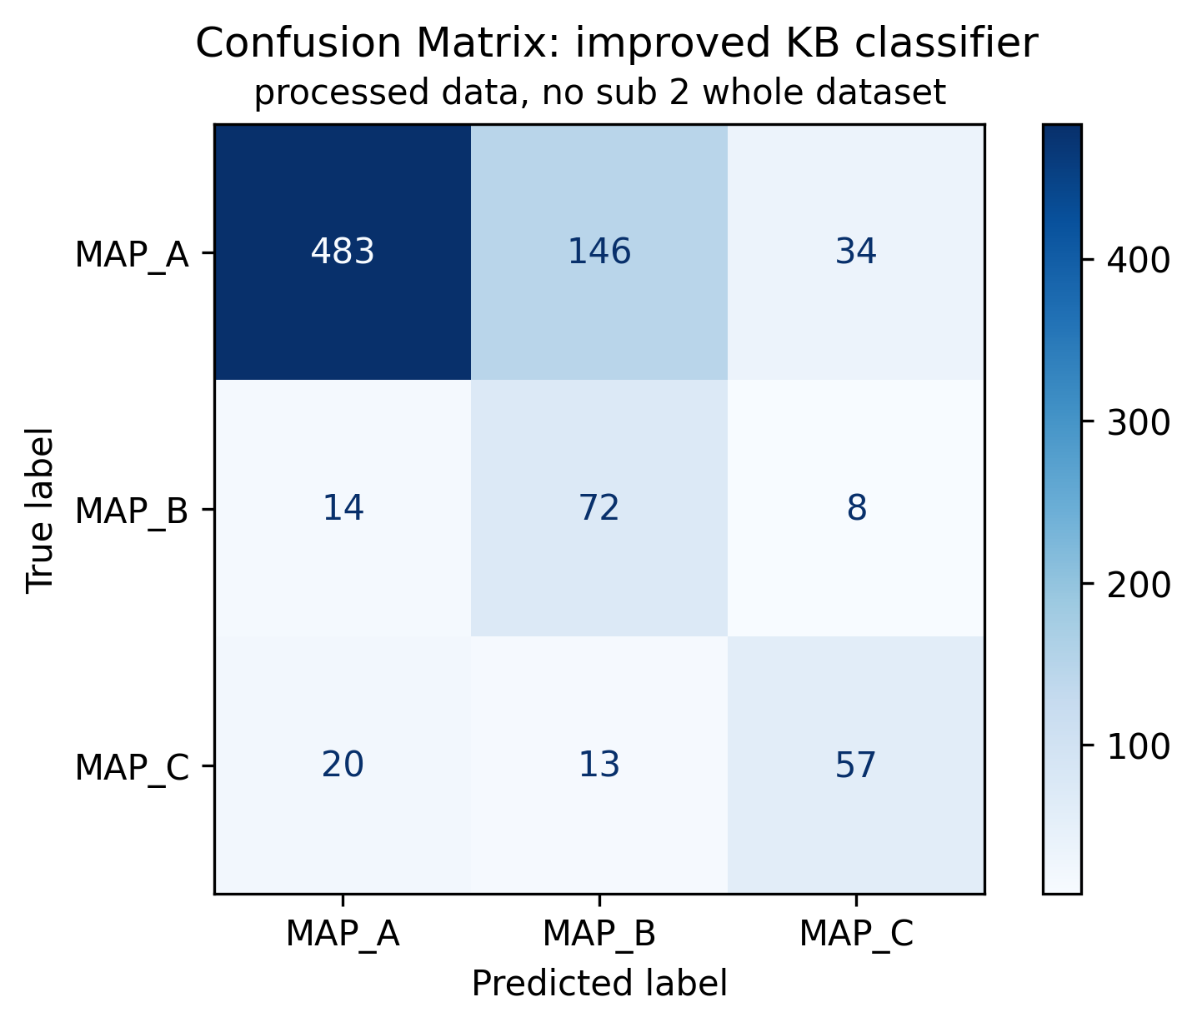
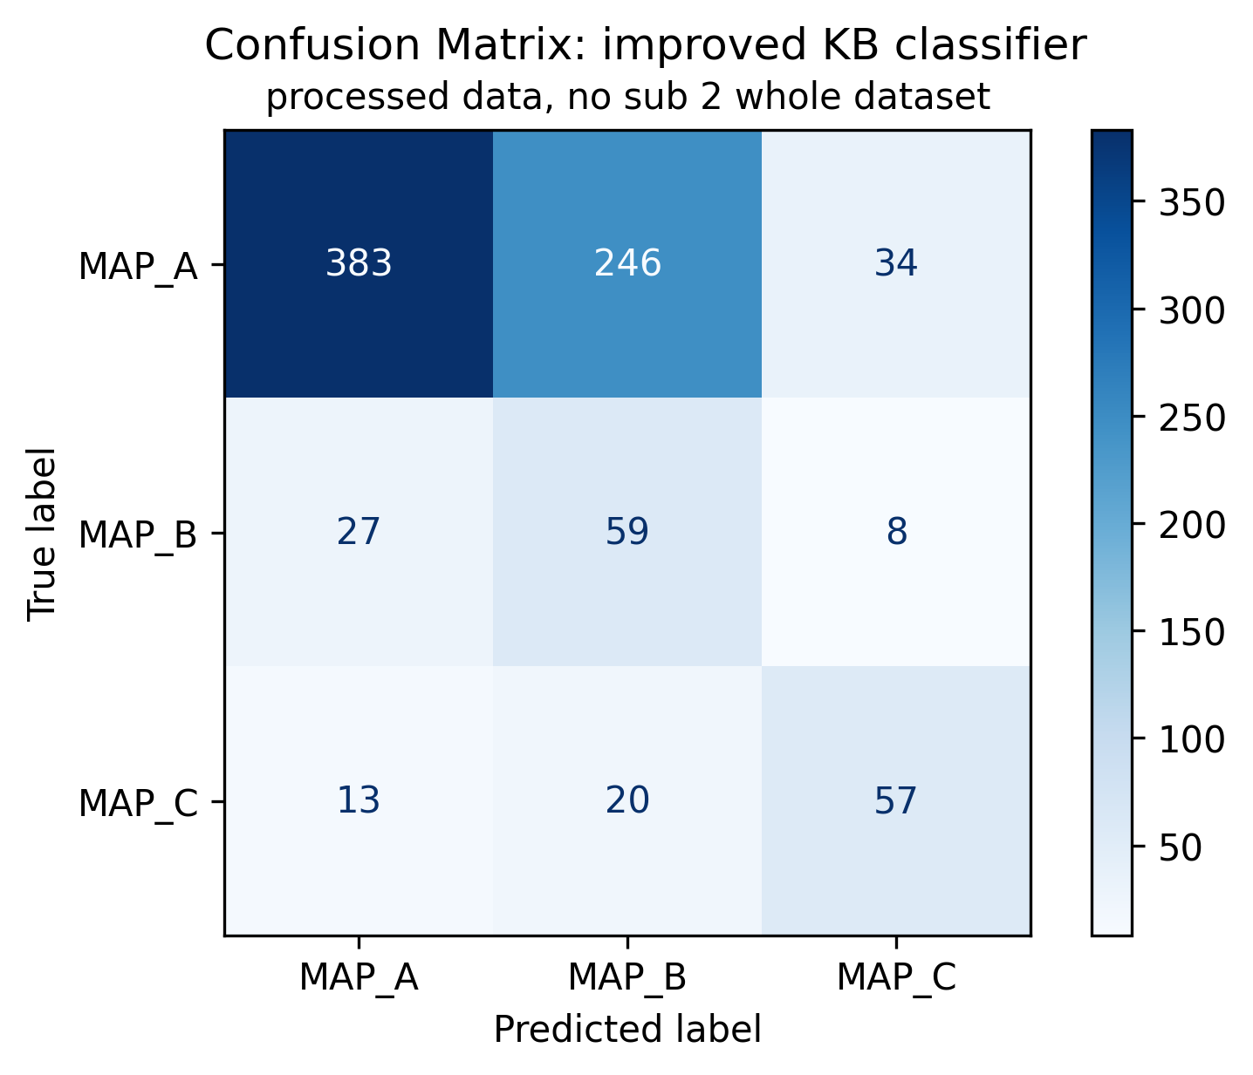
Knowledge based classifier with new features
Improved KB V0: peaks thresholds and position
Improved KB V1: peaks thresholds and atrial/ventricular ratio

